Slide 1
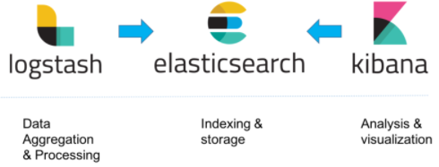
Sleep Pattern Analysis Using ELK Stack
ELK Stack:
Elasticsearch is a search and analytics engine. Logstash is a server‑side data processing pipeline that ingests data from multiple sources simultaneously, transforms it, and then sends it to a "stash" like Elasticsearch. Kibana lets users visualize data with charts and graphs in Elasticsearch

Slide 2
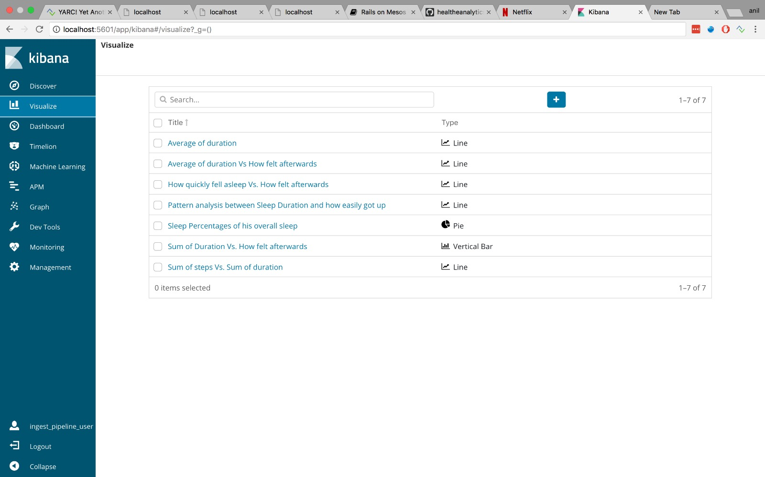
Visualizing Sleep Pattern in Kibana

Slide 3
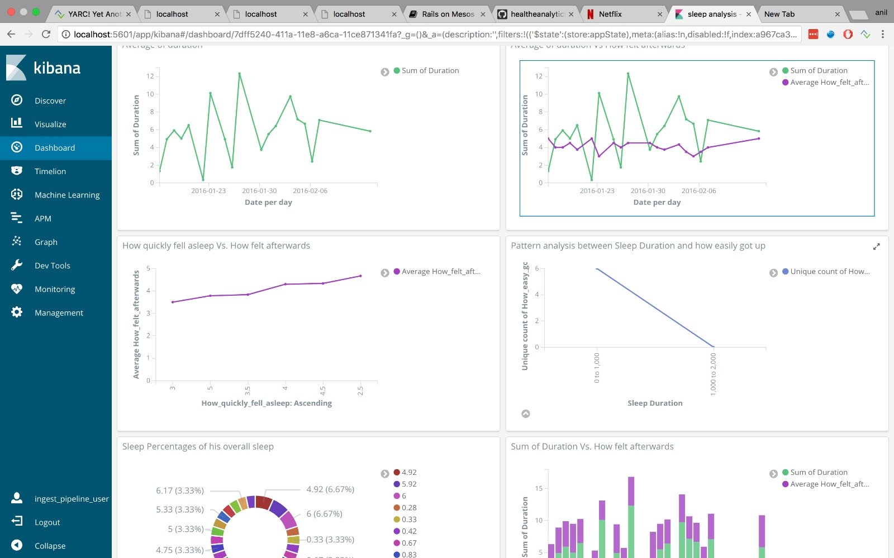
Using Dashboard to Analysis

Slide 4
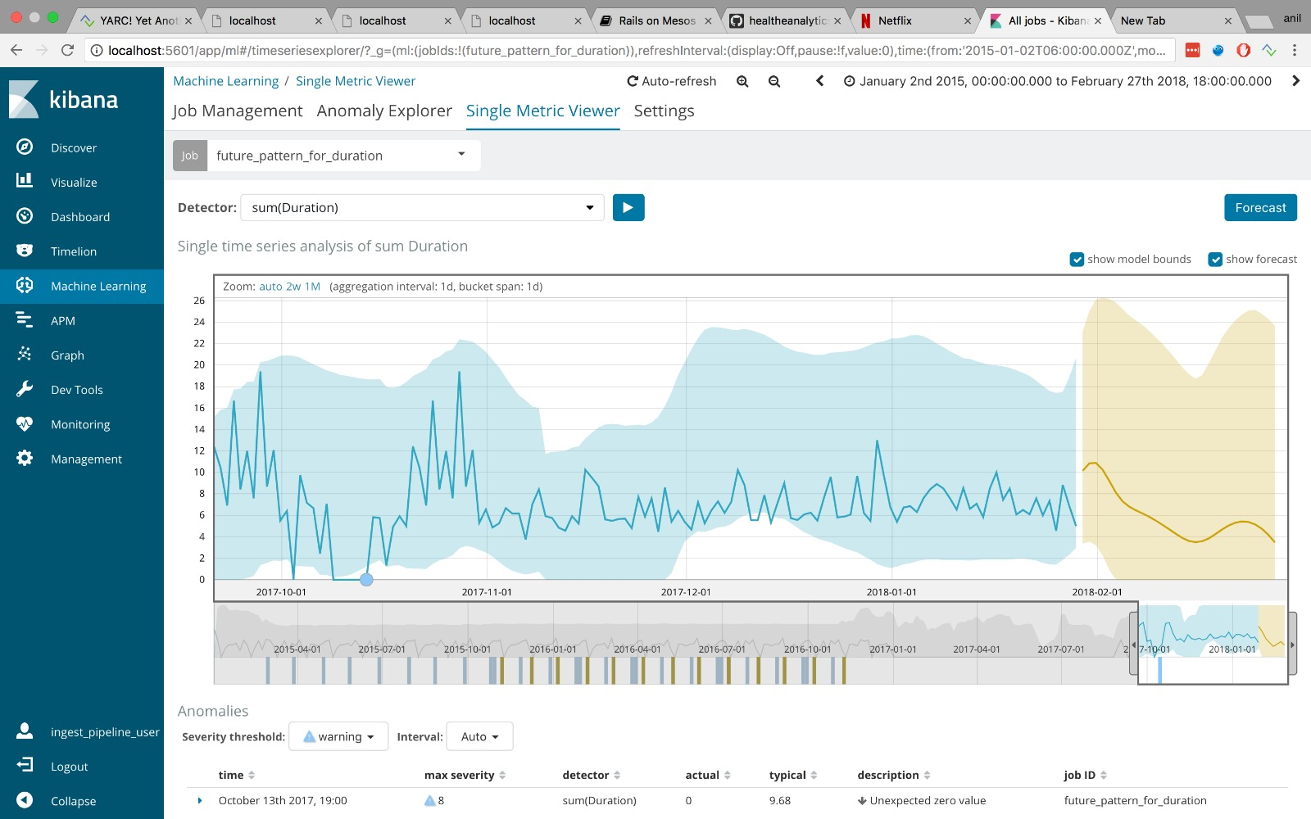
Future Predictions of Sleep Patterns

Slide 5
Future Predictions of Sleep Patterns

